Slide 1

EY Techathon 6.0 Detailed Submission
Date of submission:

Slide 2






About Team :
Team Name: Semantic _ Coder
Problem Statement : Healthcare payers struggle to maintain accurate provider directories due to manual, error-prone verification processes, leading to outdated information, member dissatisfaction, and regulatory risks.
Team Member 1
Name : Muskan Kawadkar
College name : BGI
Contact Detail : +91 96448 70597
Team Leader:
Leads the team and delivers impactful presentations.
Team Member 2 Name : Shruti Mehra
College name : BGI
Contact Detail :
+91 6264 894 435
UI/UX Designer:
Make UI to transforms ideas into meaningful user experiences.
Team Member 3 Name : Parag Tiwari
College name : BGI
Contact Detail :
+91 7489833453
Research & QA Lead:
Owns research strategy and quality assurance.
Team Member 4 Name : Musa Qureshi
College name: BGI
Contact Detail : +91 6263 473 208
Agentic Developer : Leads multi-agent design, LangGraph orchestration and AI strategy.
Team Member 5
Name : Sanskar Gupta
College name : BGI
Contact Detail :
+91 70818 91389
Data Analysis:
Prepare and inspect data
& web scraping.

Slide 3
Executive Summary :
.
The rapid evolution of the healthcare ecosystem has intensified the need for accurate, real-time provider data management. Today, over 40 to 80% of provider directory information remains inaccurate, leading to patient dissatisfaction, regulatory non-compliance, delayed care access, and significant operational inefficiencies for healthcare payers. Traditional manual validation relying on repeated provider outreach, multi-system updates, and time-intensive credential checks cannot scale to meet the industry’s increasing accuracy and timeliness requirements. Our proposed solution addresses this challenge through a simplified yet powerful Agentic AI-driven Provider Data Validation and Directory Management System, designed to automate high-volume processes while ensuring reliability, compliance, and measurable business value.
The system leverages a coordinated set of intelligent agents that autonomously extract, validate, enrich, and update provider information using publicly available datasets such as the NPI Registry, state medical boards, hospital directories, and Google Maps. By integrating web-scraping automation, LLM powered information extraction, and confidence-based cross-verification, the solution significantly reduces manual intervention while improving data quality. The agents collaboratively perform tasks including contact information validation, credential verification, data enrichment, discrepancy detection, and update orchestration across multiple downstream platforms.
This end-to-end automation reduces processing time from hours to minutes, increases accuracy through structured confidence scoring, and minimizes regulatory risk by ensuring continuously refreshed directory data. The system also enables operational scalability, allowing payers to validate 200+ profiles within a single cycle and process up to 500 profiles per hour. Through modular orchestration and robust guardrails, the solution ensures safe, compliant deployment while demonstrating the transformative potential of Agentic AI in healthcare operations. Ultimately, it delivers a clear pathway for healthcare payers to reduce costs, enhance member experience, and modernize directory management using intelligent automation

Slide 4
Problem statement :
Define the exact problem that you intend to solve and your understanding of the same. Share the below details:
Target Industry: Healthcare – Insurance Payers / Health Plan Operations
Industry Type: B2B (Healthcare Payers ↔ Provider Networks), with indirect B2C impact on members/patients .
User Group: Provider Data Management Teams, Credentialing Teams, Network Operations Analysts, Compliance Officers .
User Department: Provider Network Management, Credentialing Department, Data Quality & Compliance, Operations & Member Services.
Solution Scenario: Users upload a list of provider profiles (CSV or scanned PDFs). The Agentic AI system automatically validates each profile by checking contact details, specialties, and credentials against public sources such as the NPI Registry, state medical boards, and provider websites. Missing or inconsistent data points are enriched, flagged, or assigned confidence scores. Users review prioritized flagged cases on a dashboard and approve updates before final data is pushed into the provider directory. This ensures fast, automated, and accurate provider data validation with minimal manual work.
Proposed Data Flow: Provider data is uploaded → extracted and standardized → automatically validated via public sources → flagged items reviewed on the dashboard → approved updates synced to directories with reports generated.
Nature of Output: A web-based dashboard interface.

Slide 5
Explain, in brief, how you intend to solve the problem at hand. Preferably include the following (Methodology/approach):
Please elaborate on the solution value proposition to the target user group. How will your solution cover the problem areas?
Response: The solution automates provider data validation and directory updates using AI, reducing manual workload, improving accuracy, accelerating onboarding, and ensuring consistent, compliant, up-to-date provider information across all payer platforms.
What are the impact metrics that you propose to use to analyse the effect of the solution?
Response: Accuracy improvement, extraction accuracy, validation cycle time, manual effort reduction, confidence score reliability, directory error reduction, and cost savings from automation.
What are the technologies (languages, platforms, APIs, hardware, sponsored tools, technologies stacks, framework etc.) involved?
Response: python, Flask/FastAPI, OpenAI/Hugging Face models, VLM-based OCR, BeautifulSoup/Selenium, Pandas/NumPy, SQLite/PostgreSQL, NPI Registry API, Google Maps API, Cron/Celery, Docker.
Please state the assumptions, constraints and solution decision points (Reason behind choosing a technology)
Response: Public data sources available; scraping allowed for non-restricted sites; synthetic data used when needed; Python + modular agents chosen for speed, low cost, and scalability; OCR required for scanned and unstructured documents.
How easily can your solution be implemented and how effective will it be?
Response: Modular agents and pre-trained models allow quick deployment, delivering rapid accuracy gains, faster validations, and significant reductions in manual verification time.
How robust / secure / easily scalable and extensible is the solution?
Response: Cloud-ready modular architecture ensures security, horizontal scalability, fault tolerance, and easy extension to new data sources or payer workflows.
What are the solution components that you would like to build and demonstrate; if you progress through next round.
Response: Validation Agent, Enrichment Agent, QA Agent, OCR pipeline, Directory Management Agent, unified web dashboard, and automated reporting/email generator.

Slide 6

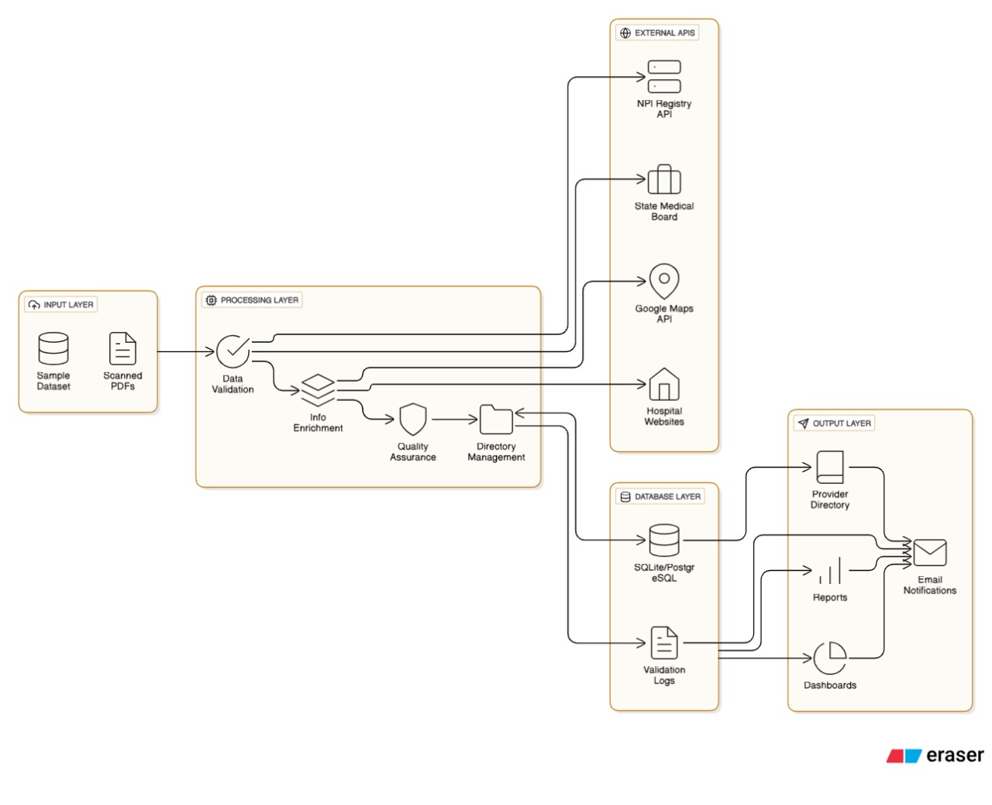
Architecture Diagram:
Inputs include sample datasets and scanned PDF documents.
The processing layer validates raw provider data for errors, completeness, and formatting.
Data is enriched by pulling additional details from external sources (NPI Registry API, State Medical Board, Google Maps API, and hospital websites).
Quality assurance checks ensure accuracy, consistency, and removal of duplicate or outdated records.
Directory management organizes and updates the final provider directory.
A database layer stores the validated/enriched provider data and validation logs using SQLite/PostgreSQL.
The output layer generates directories, reports, and dashboards for stakeholders.
Automated email notifications share the outputs and update alerts with users.

Slide 7
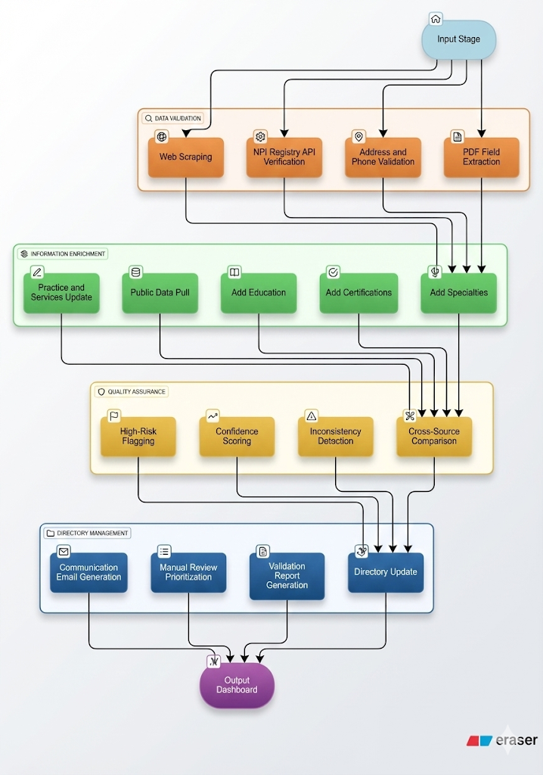
Flow Chart Diagram:
Input Stage collects raw provider data, including forms, documents, and PDFs.
Web Scraping gathers public information to cross-verify submitted provider details.
NPI Registry API Verification validates identity and confirms provider credentials.
Address and Phone Validation ensures accurate contact information through external verification tools.
PDF Field Extraction pulls structured data such as education, specialties, and certifications from uploaded PDFs.
Information Enrichment adds missing details, including practice updates, public data, education, certifications, and specialties.
Quality Assurance flags high-risk records, scores data confidence, and detects inconsistencies across sources.
Directory Management updates records, generates validation reports, and triggers communication emails for missing information.
Output Dashboard displays validated provider data, updates, reports, and insights for stakeholders.

Slide 8
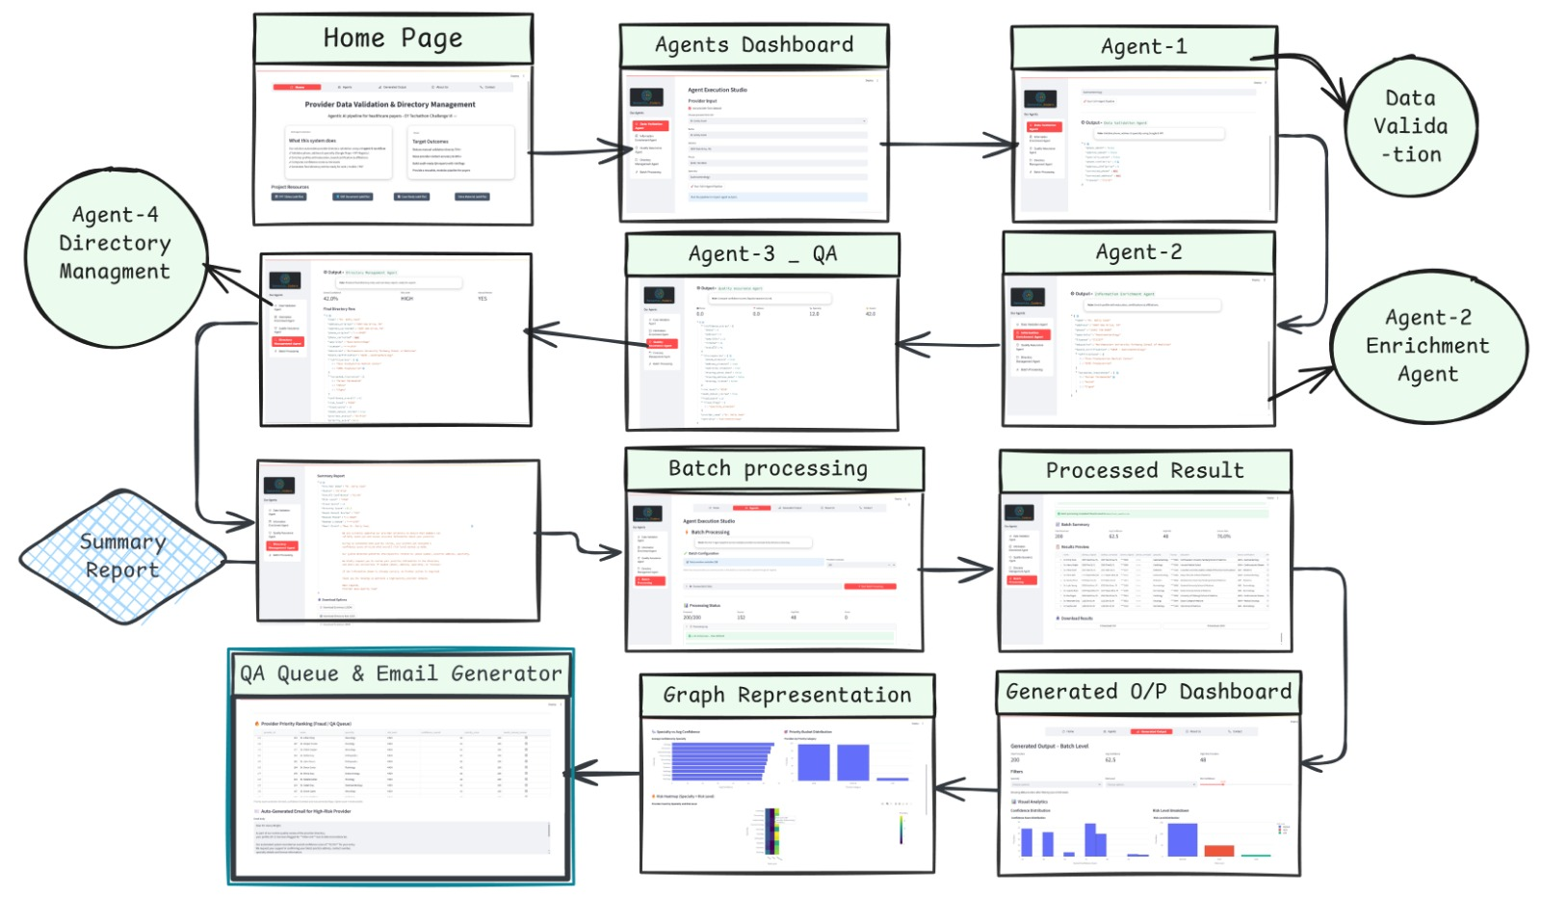
Wireframe of Healthcare Payers Agent:

Slide 9
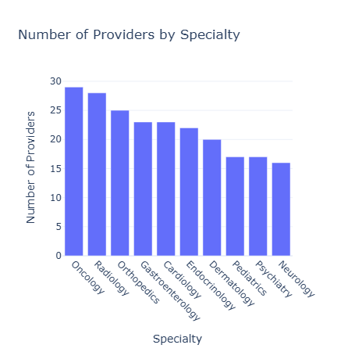
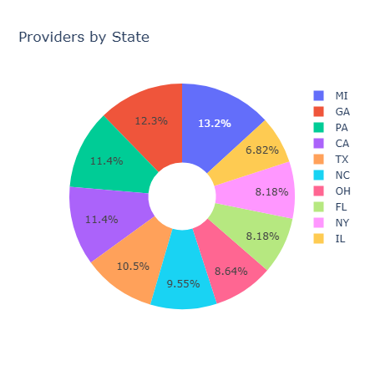
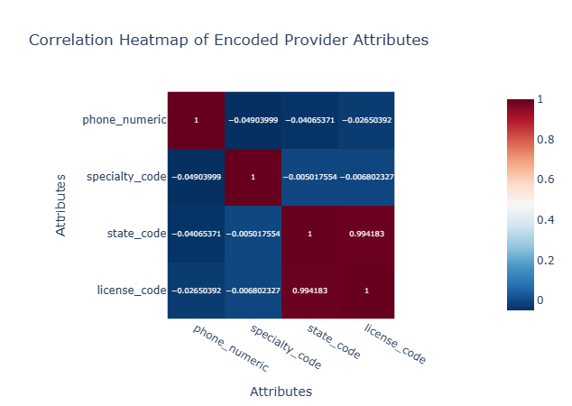
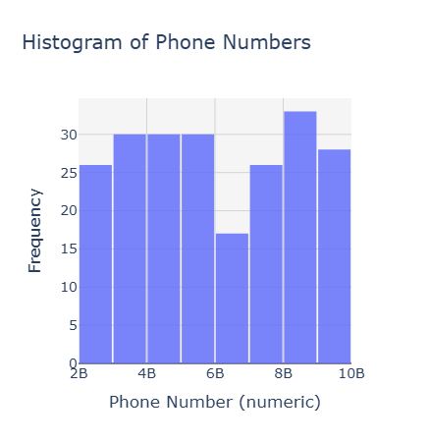
Graphical Representation :
Bar Graph:
Pie Charts:
HeatMap:
Histogram:

Slide 10


Video, link for demo: [https://shorturl.at/pRUj5] Video, link for Presentation: [ ] Working prototype/output (Deployed web app): [https://healthcare-x-multi-agent.streamlit.app/] Github Repository/Source Code: [https://github.com/Musa-Qureshi-01/Healthcare_MultiAgent.git]

